Slide 2


Slide 3
Plan for today
Fixed effects
Value-added models
Randomized experiments

Slide 4
Fixed effects

Slide 5
Intuition
Let’s control for all the things that won’t change for each unit… forever and always.
Let’s subtract out any differences in both X and Y between units.
Let’s focus on how X and Y covary within units.

Slide 6
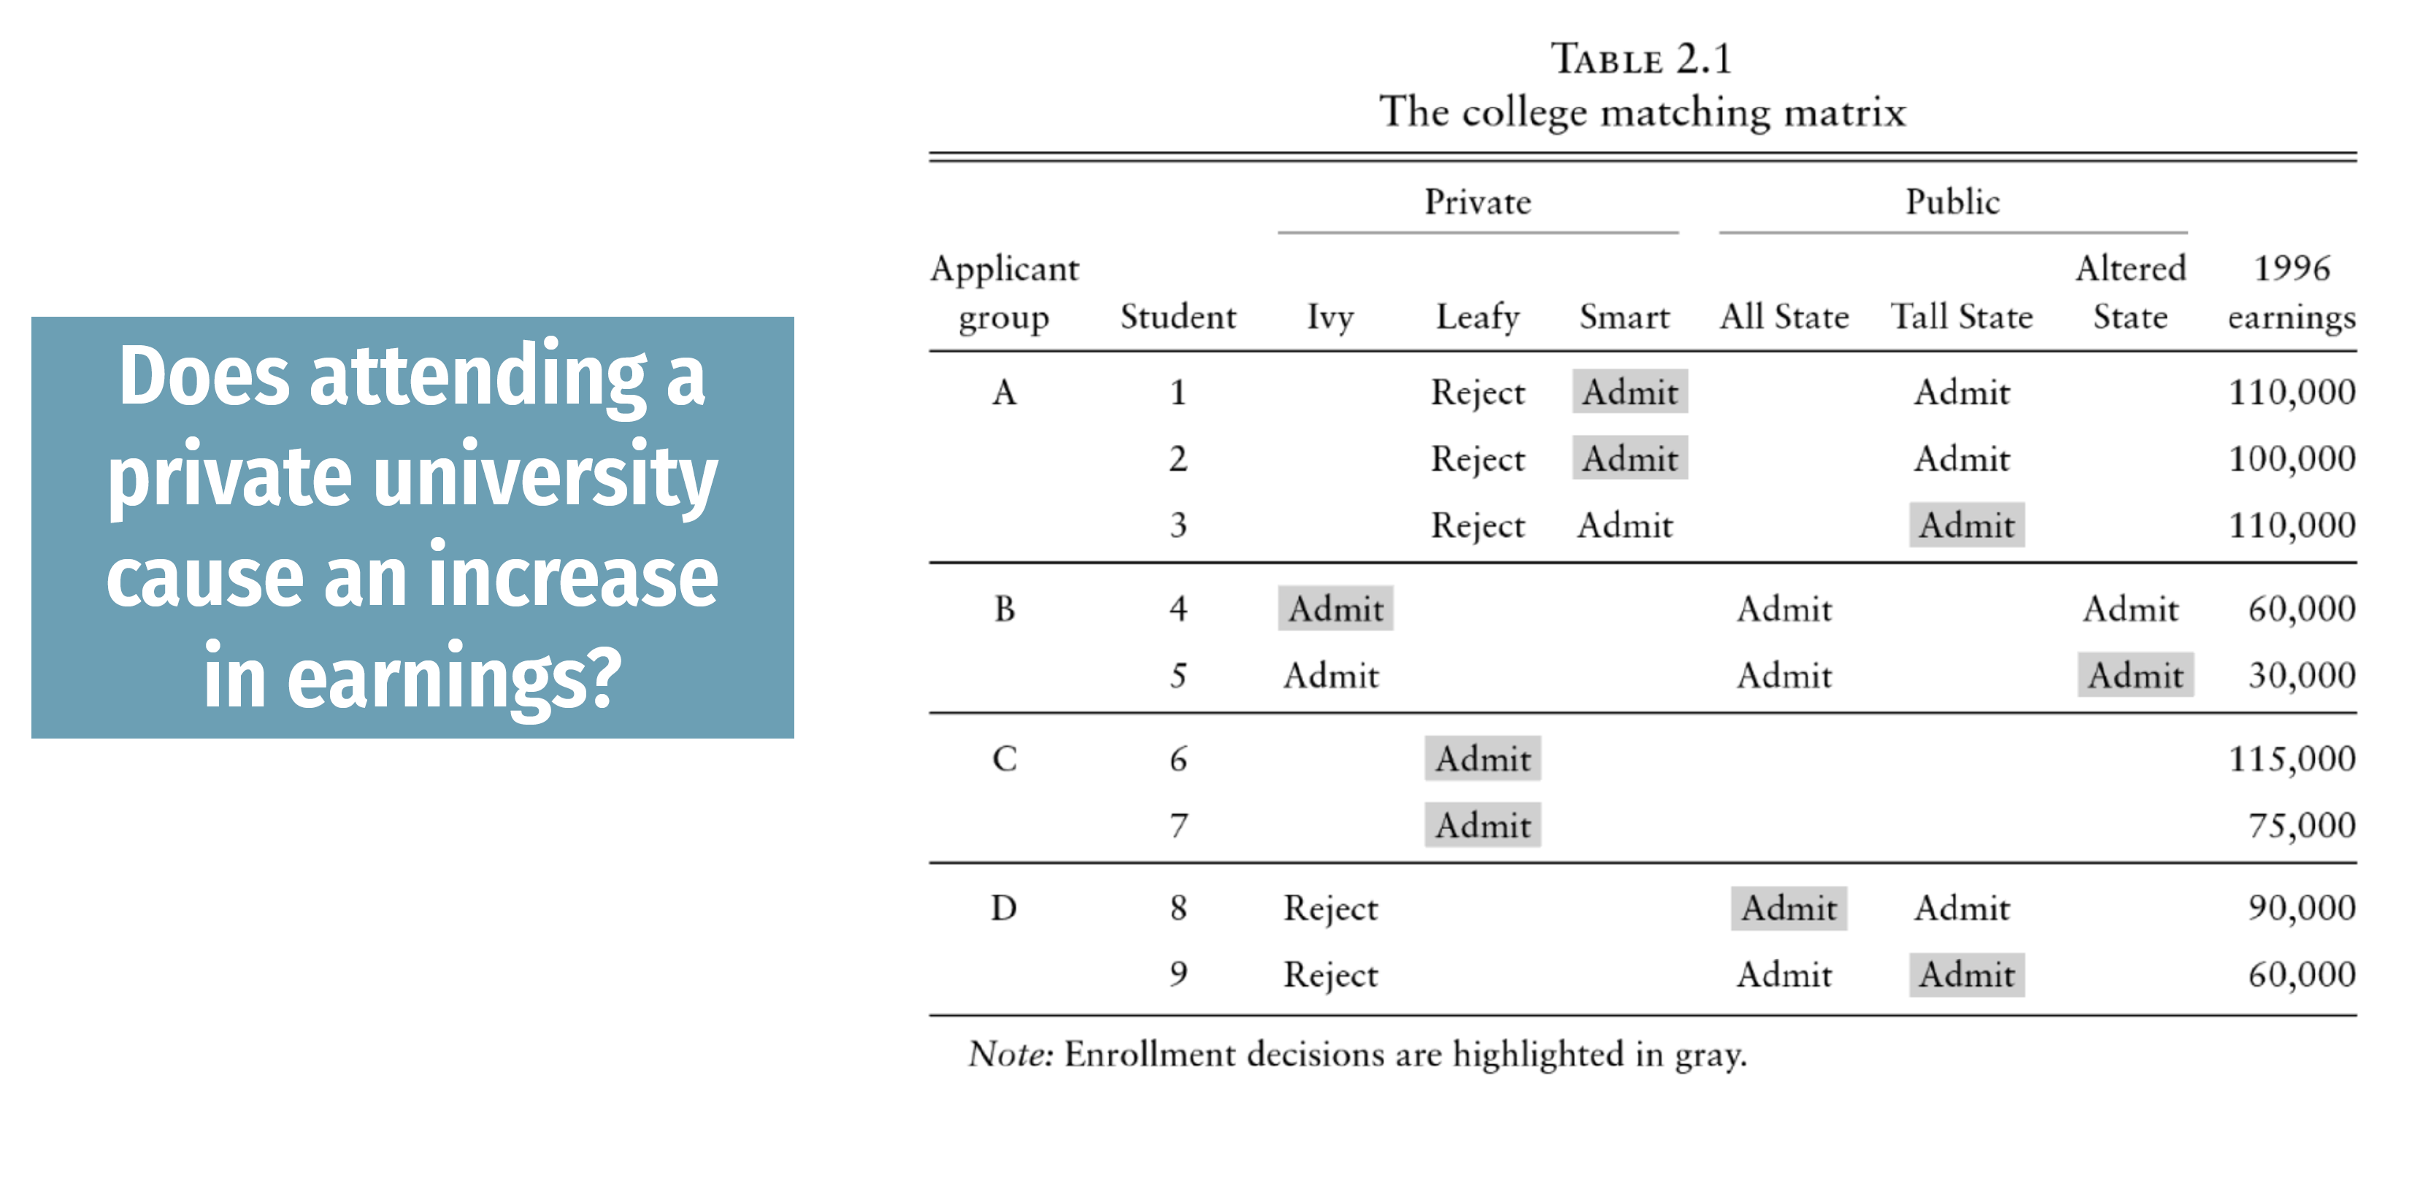
Adjusting for group membership

Slide 7
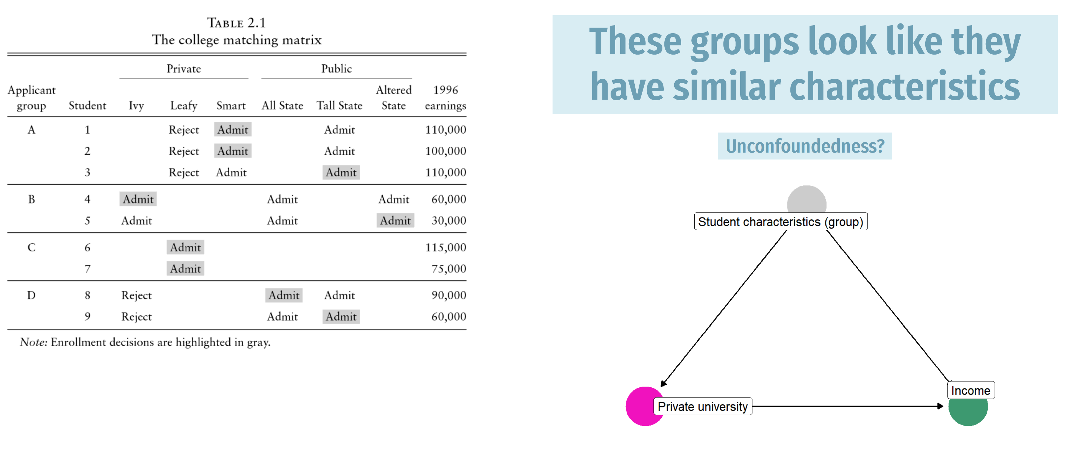
A vs B captures stuff we cannot measure

Slide 8

Adjusting for group membership, manually

Slide 9
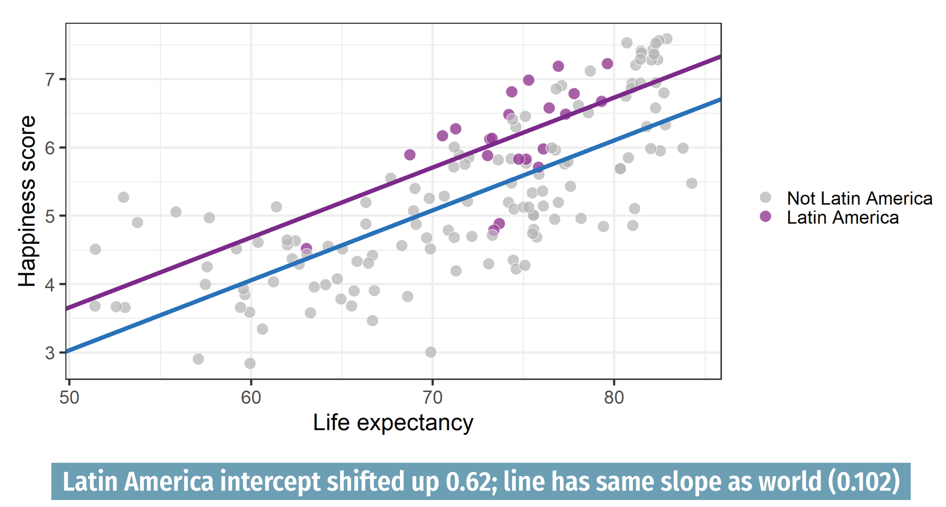
Remember dummy variables?

Slide 10
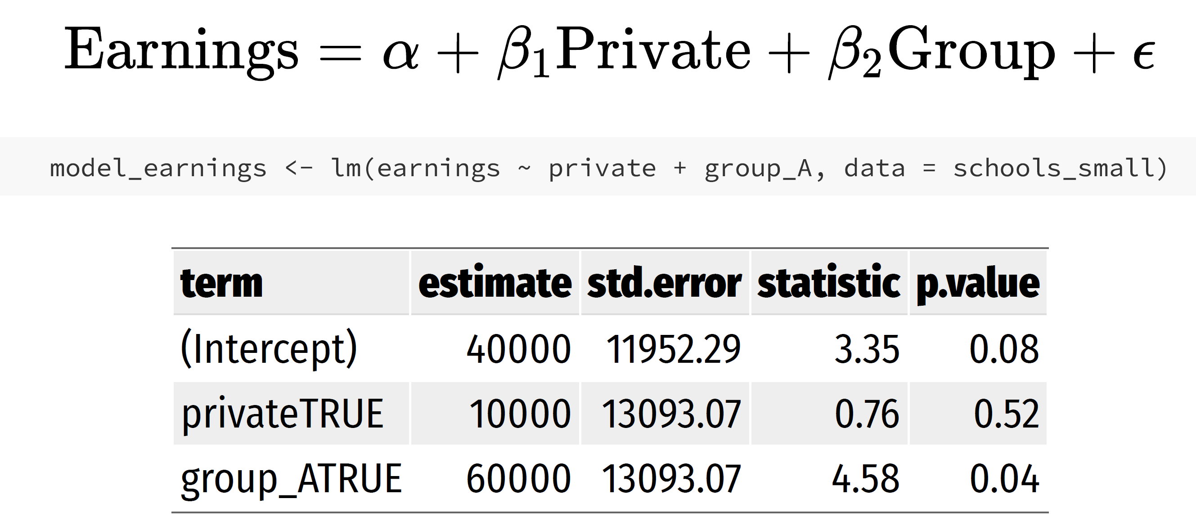
Within-group comparisons using dummies

Slide 11

What if we have many groups?
No problem.

Slide 12
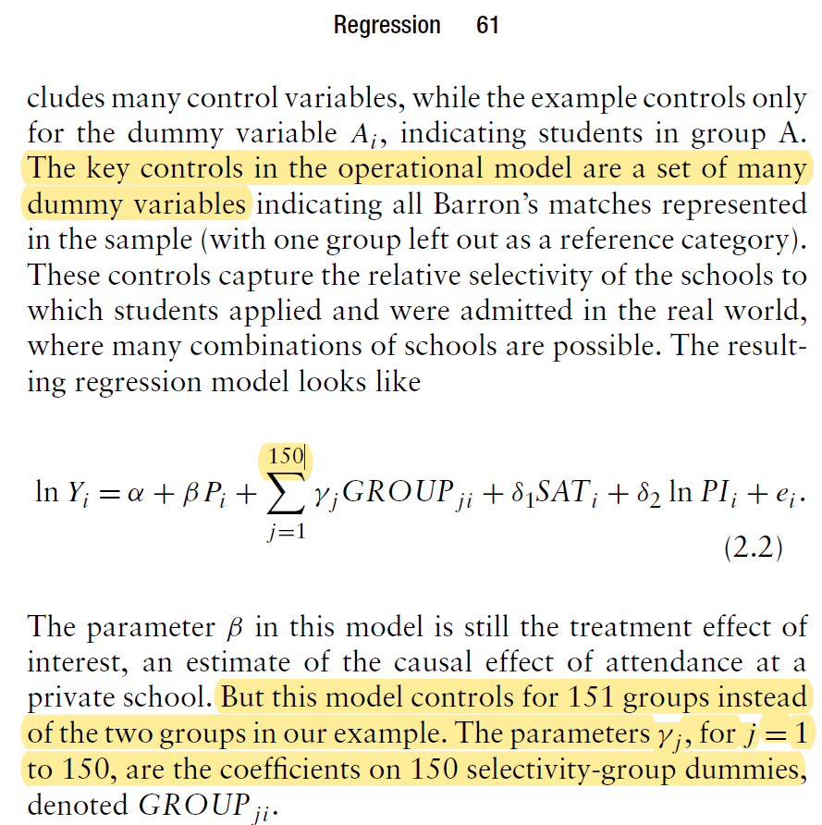
What if we have many groups?
Seriously.

Slide 13
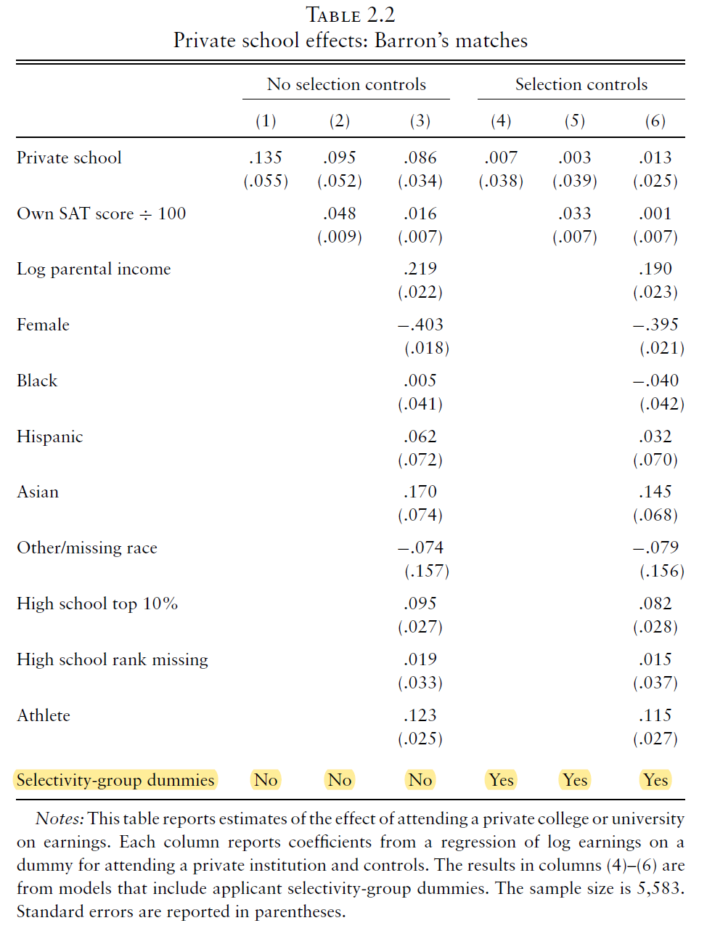

Slide 14
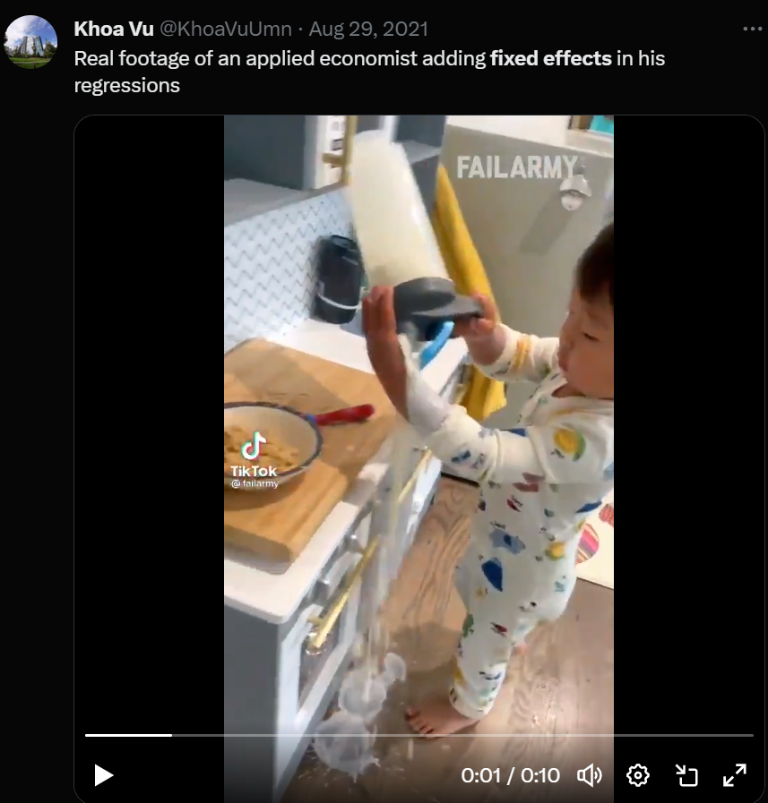


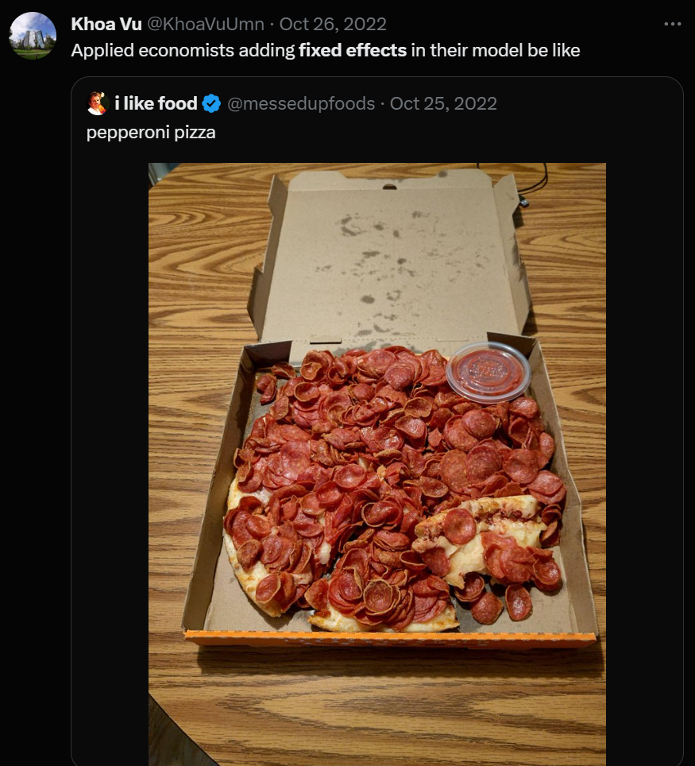

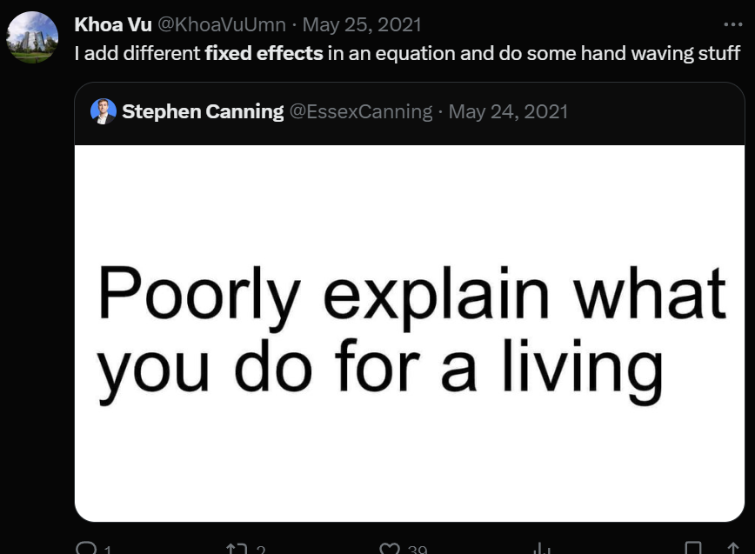
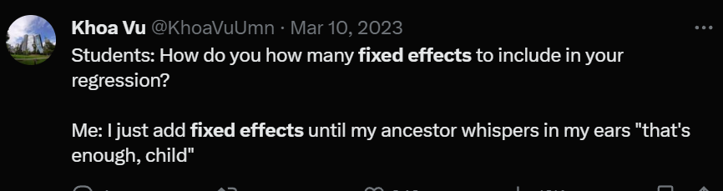


What if we have many different groups?
No problem!

Slide 15
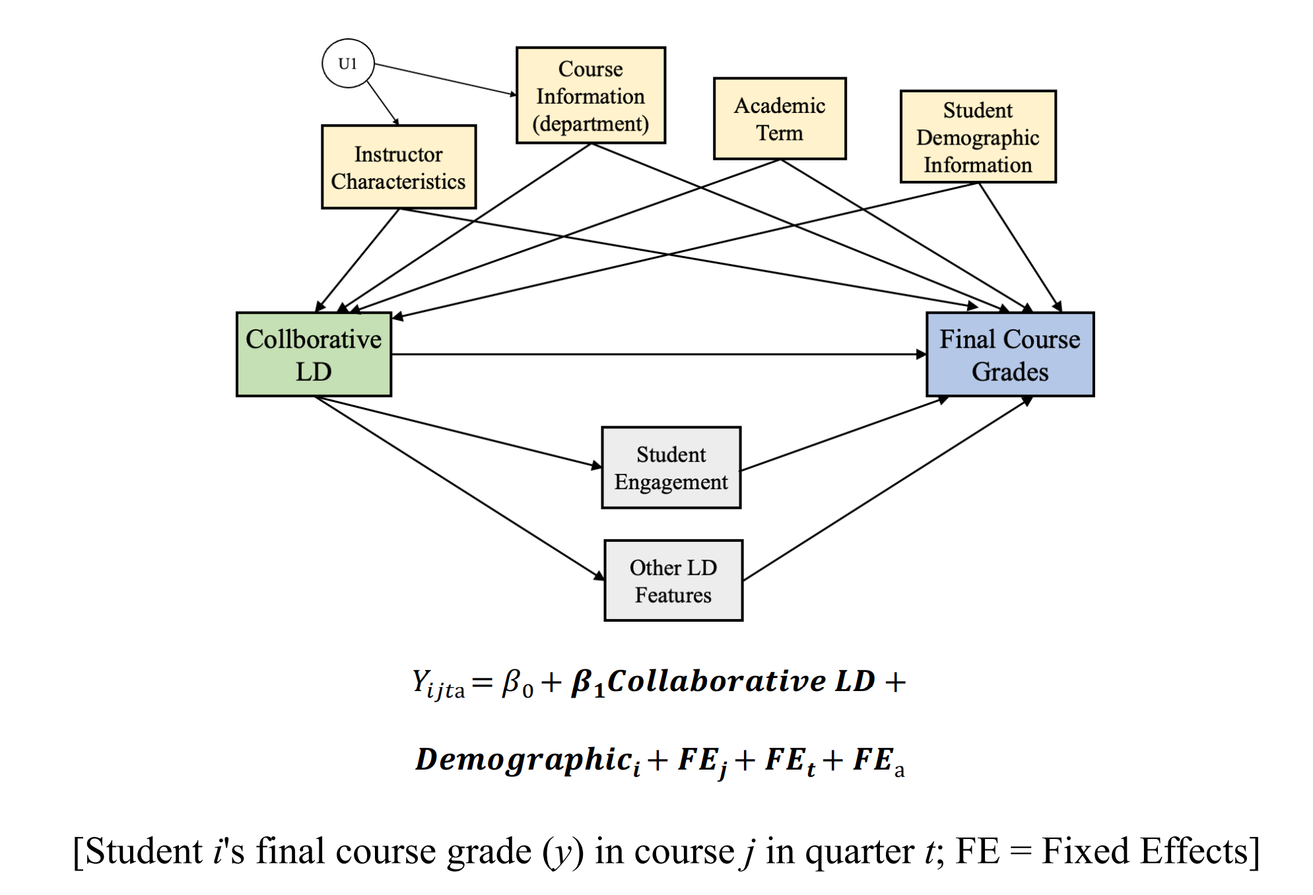
What if we have many different groups?
In his analysis on the causal effect of collaborative learning design on student learning, Jinwon Kim (2024) uses…

Slide 16
Value-added models

Slide 17
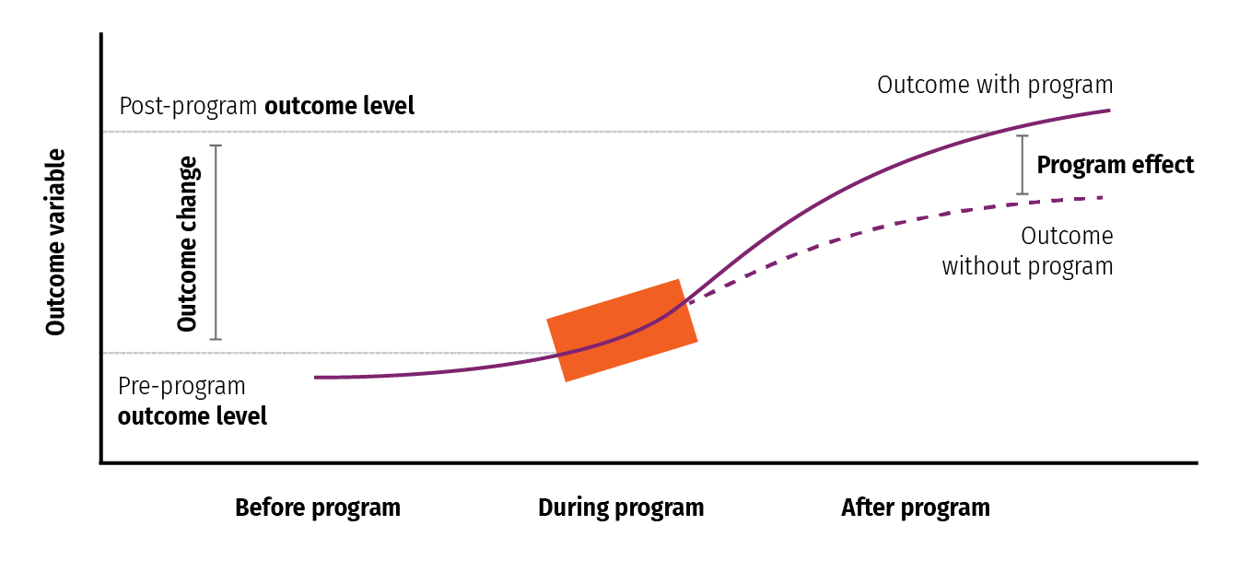
Measuring the causal effect of a teacher
aka the Andy effect
Counter-factual
aka the Andy program

Slide 18
VAMs: Not just relevant for teachers
Teacher value added
School value added
Firm value added
Etc.

Slide 19
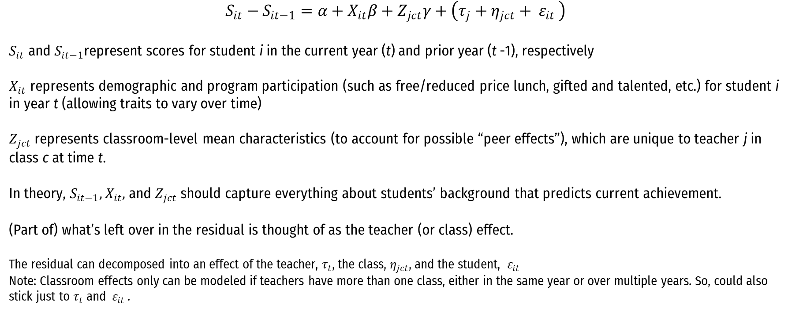
VAM 1: Gain-score model
$$S_{it}−S_{it−1}=α+X_{it}β+Z_{jct}γ+\left(τ_{j}+{η_{jct}+ ε}_{it }\right)$$
$S_{it}$ and $S_{it−1}$represent scores for student i in the current year (t) and prior year (t -1), respectively
$X_{it}$ represents demographic and program participation (such as free/reduced price lunch, gifted and talented, etc.) for student i in year t (allowing traits to vary over time)
$Z_{jct}$ represents classroom-level mean characteristics (to account for possible “peer effects”), which are unique to teacher j in class c at time t.
In theory, $S_{it−1}, X_{it},$ and $Z_{jct}$ should capture everything about students’ background that predicts current achievement.
(Part of) what’s left over in the residual is thought of as the teacher (or class) effect.
The residual can decomposed into an effect of the teacher, $τ_{t}$, the class, $η_{jct}$, and the student, ${ ε}_{it }$
Note: Classroom effects only can be modeled if teachers have more than one class, either in the same year or over multiple years. So, could also stick just to $τ_{t}$and ${ ε}_{it }$.
This looks very similar to our plain-ole-vanilla multivariate regression with controls. Two differences: (1) outcome measure is a difference, and (2) error term is decomposed into multiple parts.

Slide 20
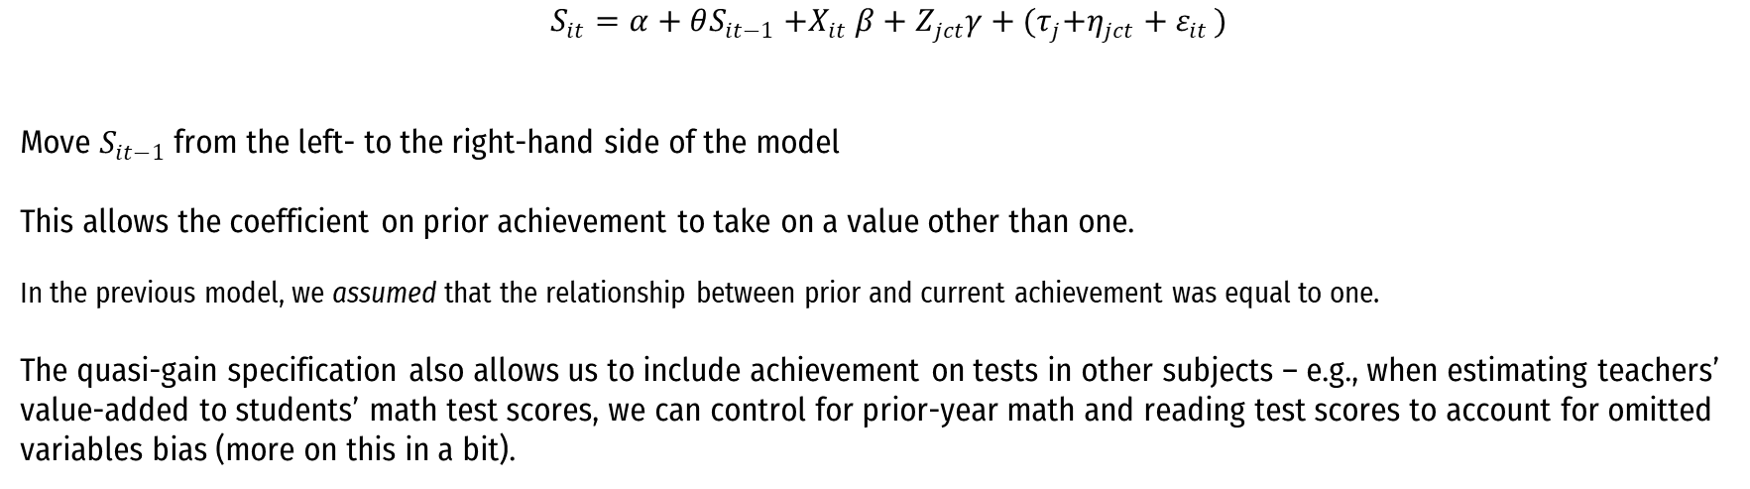
VAM 2: Quasi-gain or lagged-score model
$$S_{it}=α+θS_{it−1}{+X}_{it}β+Z_{jct}γ+{(τ}_{j}{+η}_{jct}+ε_{it })$$
Move $S_{it−1}$ from the left- to the right-hand side of the model
This allows the coefficient on prior achievement to take on a value other than one.
In the previous model, we assumed that the relationship between prior and current achievement was equal to one.
The quasi-gain specification also allows us to include achievement on tests in other subjects – e.g., when estimating teachers’ value-added to students’ math test scores, we can control for prior-year math and reading test scores to account for omitted variables bias (more on this in a bit).
This looks even more like plain-ole-vanilla multivariate regression with controls.

Slide 21
The statistical model in pictures
Step 1: Predict the test score growth of each student, based on factors beyond the teacher’s control (e.g., the student’s prior achievement, student characteristics, and peer characteristics).
Step 2: Calculate actual test score growth for each student (i.e., this year’s standardized test score minus last year’s standardized test score).
Step 3: Calculate the difference between actual and predicted test score growth for each student. This difference estimates the teacher’s contribution to each student’s test score growth. The average difference across all of a teacher’s students is an estimate of the teacher’s effect on student test score.
1. Predicted
Growth

Slide 22
The statistical model in pictures
Step 1: Predict the test score growth of each student, based on factors beyond the teacher’s control (i.e., the student’s prior achievement, student characteristics, and peer characteristics).
Step 2: Calculate actual test score growth for each student (i.e., this year’s standardized test score minus last year’s standardized test score).
Step 3: Calculate the difference between actual and predicted test score growth for each student. This difference estimates the teacher’s contribution to each student’s test score growth. The average difference across all of a teacher’s students is an estimate of the teacher’s effect on student test score.
2. Actual
Growth
1. Predicted
Growth

Slide 23
Another way to look at it
Note: Each dot is a student in one of two teachers’ classrooms.

Slide 24
Looks familiar?

Slide 25
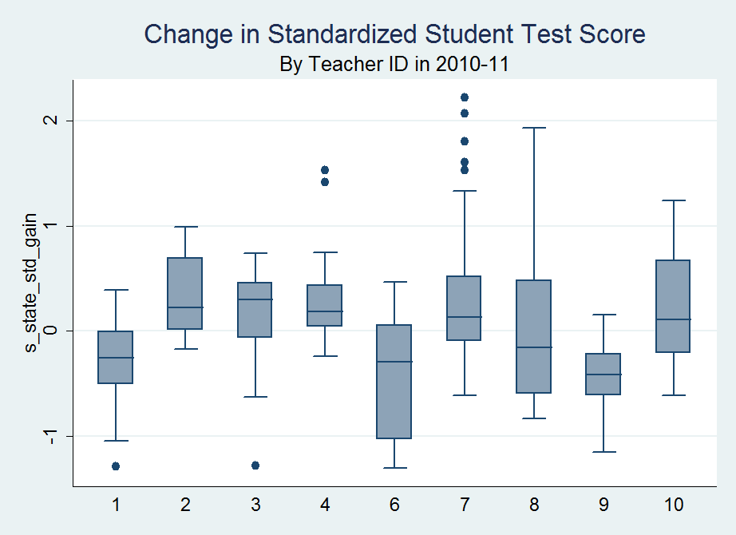
Looking across more teachers…
Which teacher would you prefer your kids, nieces/nephews to have? Why?

Slide 26
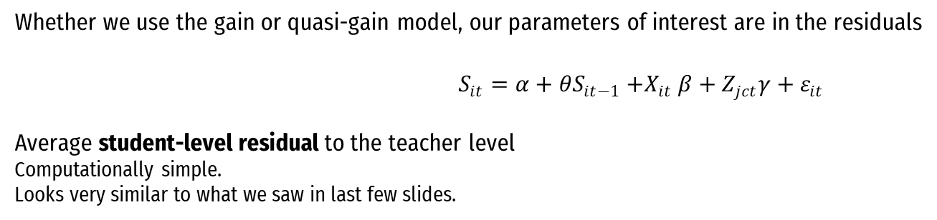
Estimating the teacher effect
Whether we use the gain or quasi-gain model, our parameters of interest are in the residuals
$$S_{it}=α+θS_{it−1}{+X}_{it}β+Z_{jct}γ+ε_{it }$$
Average student-level residual to the teacher level
Computationally simple.
Looks very similar to what we saw in last few slides.

Slide 27
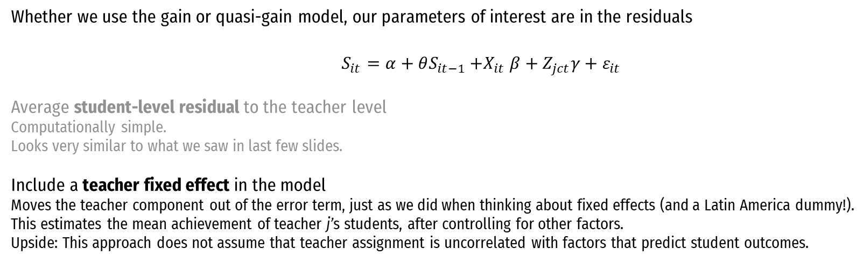
Estimating the teacher effect
Whether we use the gain or quasi-gain model, our parameters of interest are in the residuals
$$S_{it}=α+θS_{it−1}{+X}_{it}β+Z_{jct}γ+ε_{it }$$
Average student-level residual to the teacher level
Computationally simple.
Looks very similar to what we saw in last few slides.
Include a teacher fixed effect in the model Moves the teacher component out of the error term, just as we did when thinking about fixed effects (and a Latin America dummy!).
This estimates the mean achievement of teacher j’s students, after controlling for other factors.
Upside: This approach does not assume that teacher assignment is uncorrelated with factors that predict student outcomes.

Slide 28
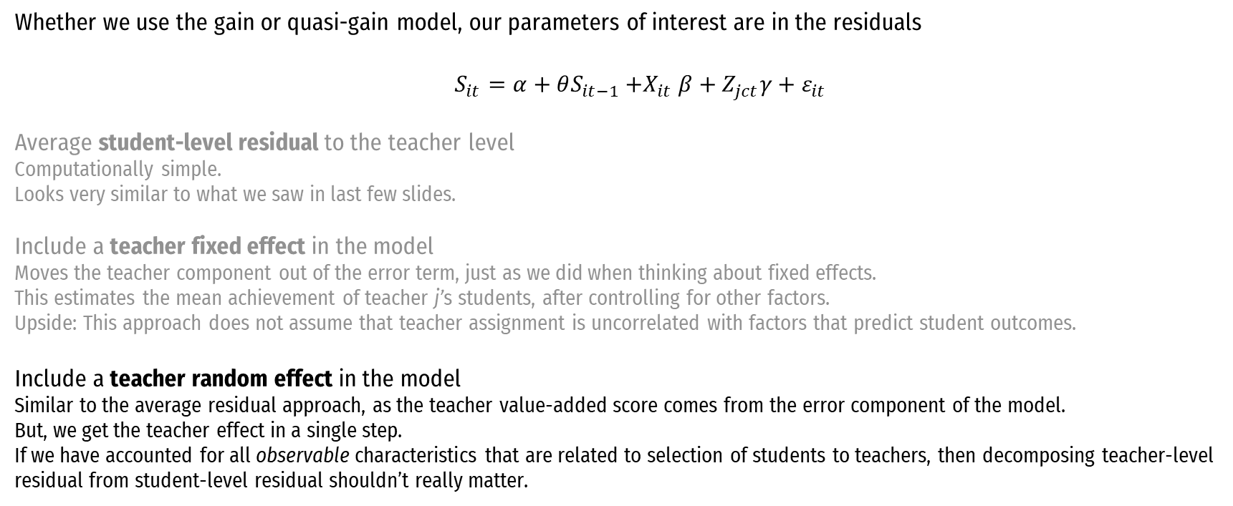
Estimating the teacher effect
Whether we use the gain or quasi-gain model, our parameters of interest are in the residuals
$$S_{it}=α+θS_{it−1}{+X}_{it}β+Z_{jct}γ+ε_{it }$$
Average student-level residual to the teacher level
Computationally simple.
Looks very similar to what we saw in last few slides.
Include a teacher fixed effect in the model Moves the teacher component out of the error term, just as we did when thinking about fixed effects.
This estimates the mean achievement of teacher j’s students, after controlling for other factors.
Upside: This approach does not assume that teacher assignment is uncorrelated with factors that predict student outcomes.
Include a teacher random effect in the model
Similar to the average residual approach, as the teacher value-added score comes from the error component of the model.
But, we get the teacher effect in a single step.
If we have accounted for all observable characteristics that are related to selection of students to teachers, then decomposing teacher-level residual from student-level residual shouldn’t really matter.

Slide 29
Estimating value-added with Stata
Average student-level residual to the teacher level
regress outcome controls
predict student_residuals, residuals
egen value_added = mean(student_residuals), by(teacher)

Slide 30
Estimating value-added with Stata
Average student-level residual to the teacher level
Linear regression with teacher fixed effects
regress outcome controls
predict student_residuals, residuals
egen value_added = mean(student_residuals), by(teacher)
areg outcome controls, absorb(teacher)
predict value_added, d

Slide 31
Estimating value-added with Stata
Average student-level residual to the teacher level
Linear regression with teacher fixed effects:
Hierarchical model with teacher-level random effects
regress outcome controls
predict student_residuals, residuals
egen value_added = mean(student_residuals), by(teacher)
areg outcome controls, absorb(teacher)
predict value_added, d
xtmixed outcome controls || teacher: || classroom:
predict value_added, reffect

Slide 32
Are VAMs “good” or “bad”?
Causal identification Unconfoundedness No omitted variable bias
Precision, esp. if used for that one teacher
Relevance, esp. if outcomes are multi-dimensional

Slide 33
Closing all backdoors in this DAG (?)
Usually, VAMs control for…
Student prior achievement
Student demographics
Peer characteristics
Sometimes: School fixed effects

Slide 34

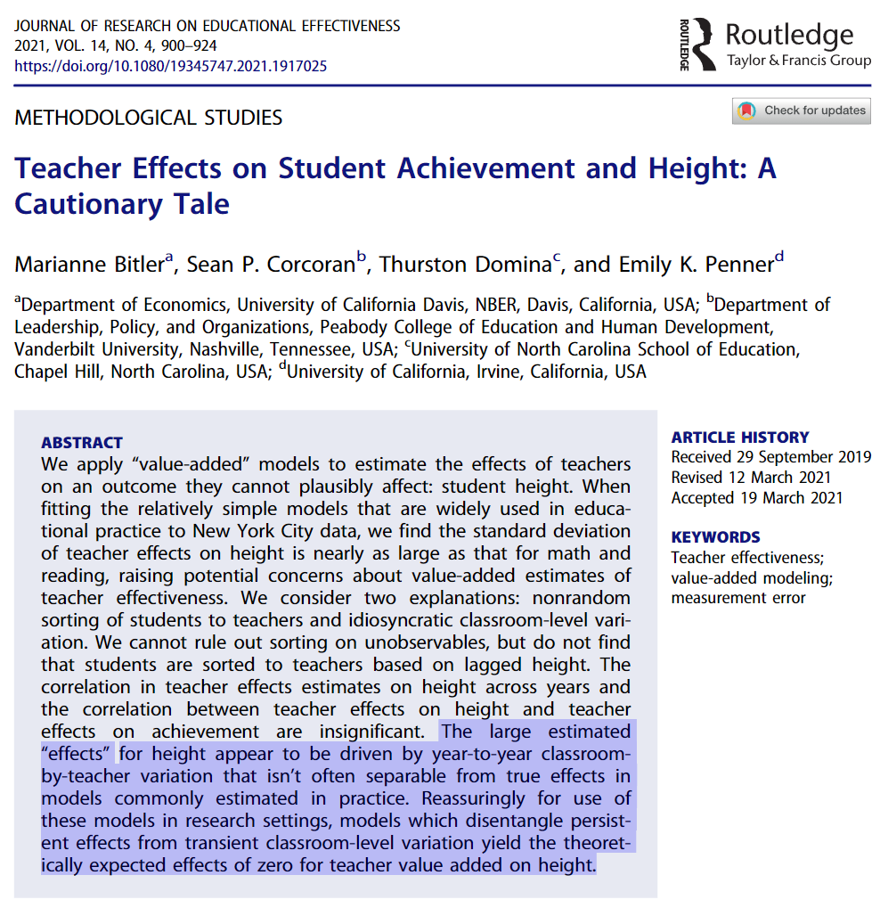

For your leisure reading…

Slide 35

Precision: Why bother?
Let’s borrow from the “Are test scores useful?” discussion

Slide 36
Addressing (im)precision
Aggregate across teachers (above, move from “individuals” to “groups”)
Use multiple years
Shrink noisy estimates

Slide 37
Year-to-Year Correlation of 0.5
Pick three teachers (i.e., data points) (1) close to best-fit line, (2) above best-fit line, (3) below best-fit line. What might these teachers say about their value-added scores?

Slide 38
Year-to-Career Correlation of 0.75

Slide 39
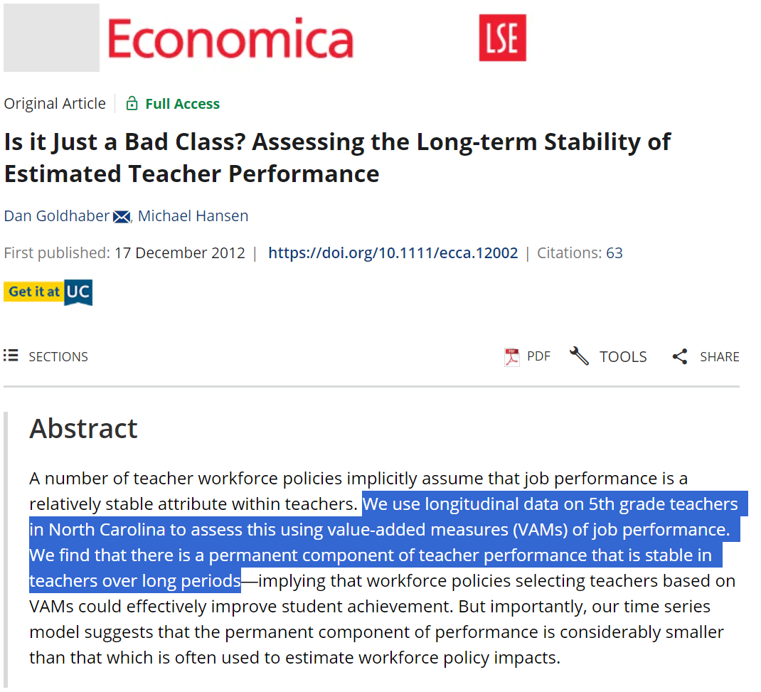
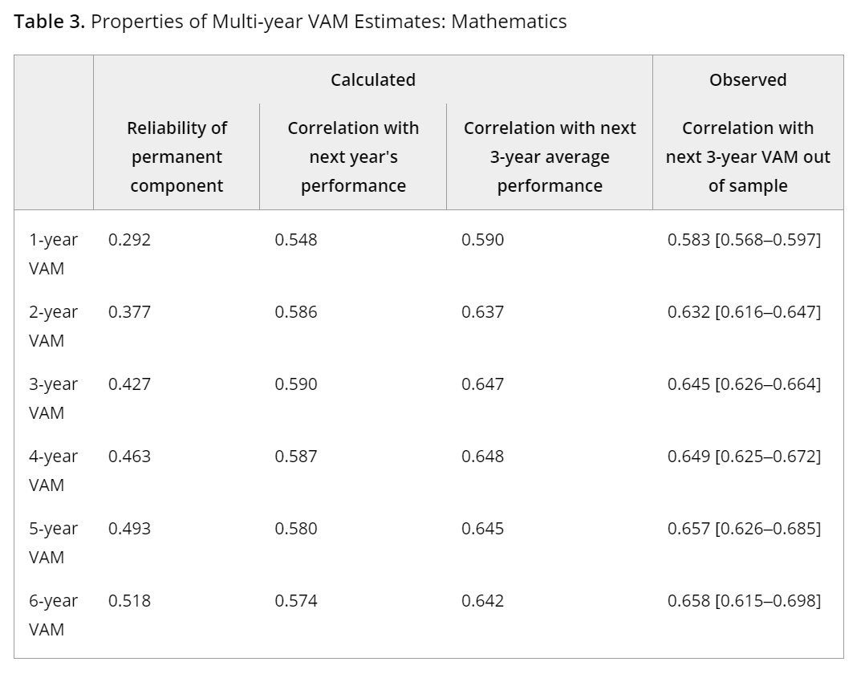
Solution 1: Include Multiple Years

Slide 40
Solution 2: Shrink Noisy Estimates
More student observations lead to
more reliable estimates.

Slide 41
Solution 2: Shrink Noisy Estimates
More student observations lead to
more reliable estimates.

Slide 42
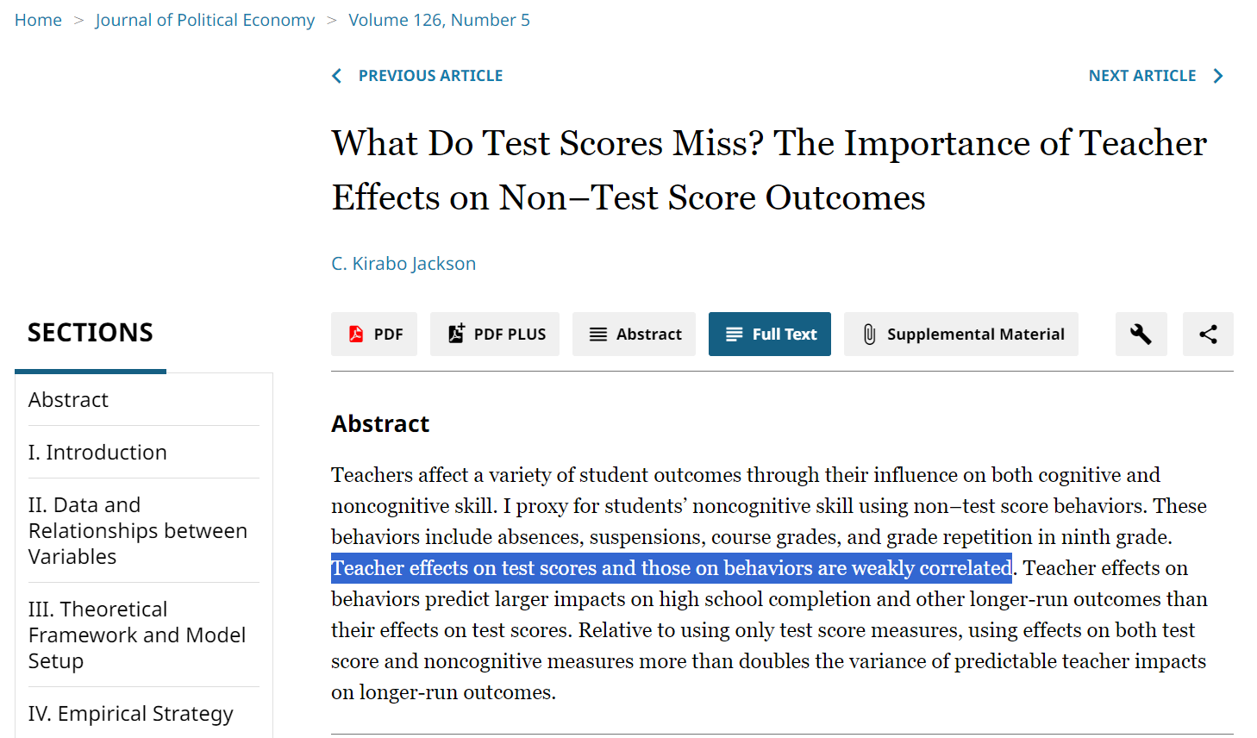


Relevance: Multi-dimensional outcomes

Slide 43
Announcements
Reading reactions
Due on Wednesday
Your paper
Look for my feedback at the end of the week
Exam in next week’s lab session
Rough study guide posted on the course website

